Slide 1
TypeScript Advanced
Bootcamp [TypeScript]
Dmitry Kiselyov

Slide 2

Bootcamp [TypeScript]

Slide 3
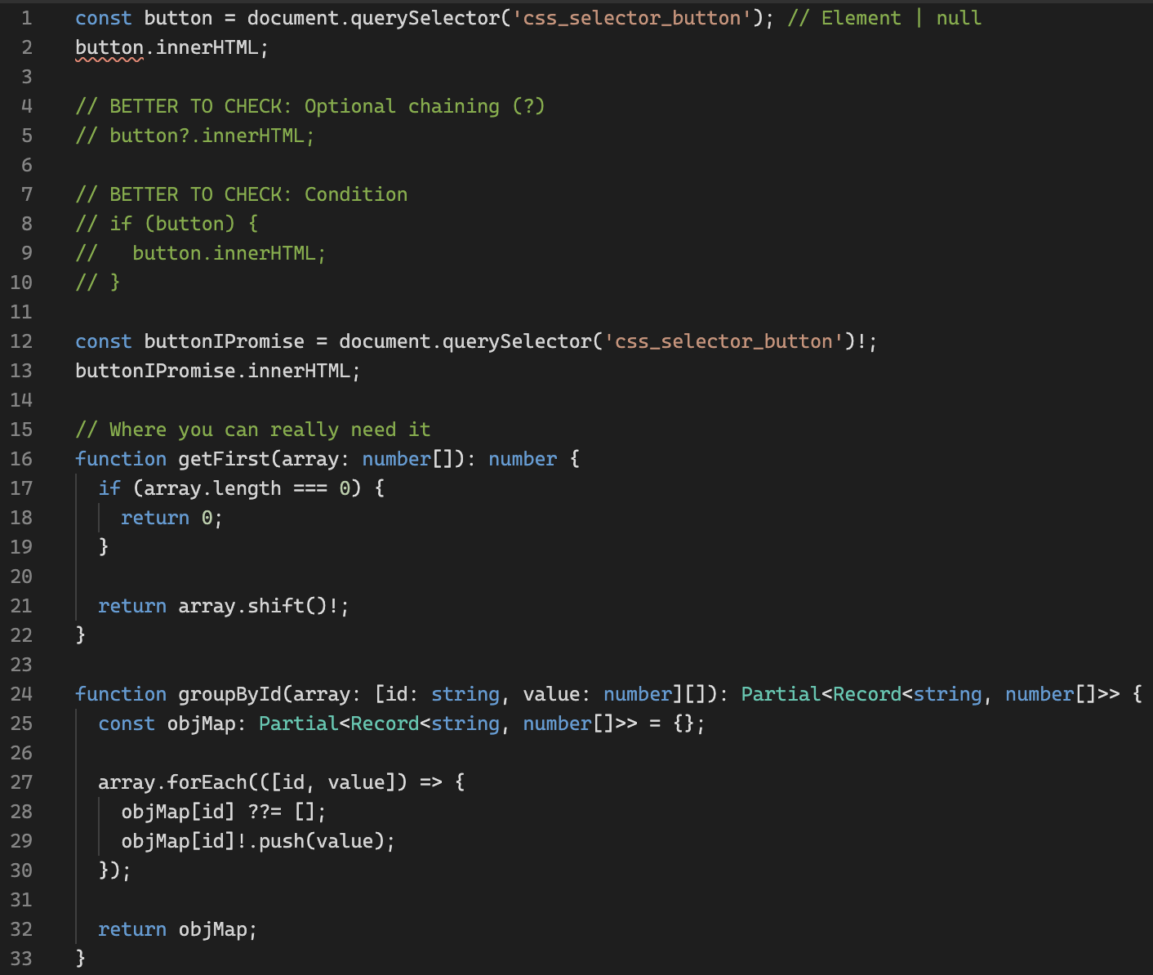
Non-null Assertion Operator (Postfix!)
Playground link
Bootcamp [TypeScript]

Slide 4
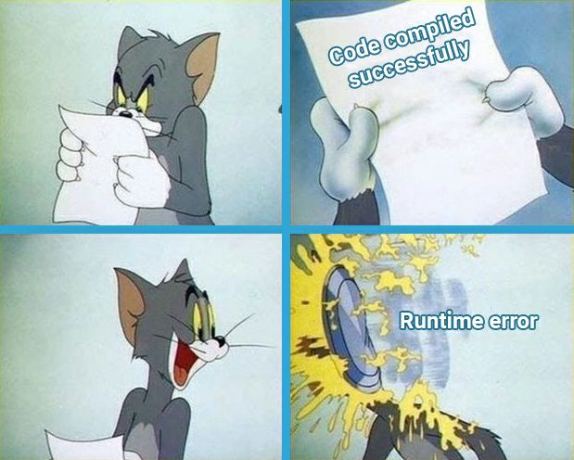
Non-null Assertion Operator (Postfix!)
Bootcamp [TypeScript]

Slide 5
object VS Object VS { }
JS | TS
null | null
undefined | undefined
boolean | boolean / Boolean
string | string / String
symbol | symbol / Symbol
number | number / Number
bigint | bigint
object | object / Object
function | Function
 | any
 | unknown
 | Array / [] / Tuple
 | void
 | never
 | enum
Don’t ever use the types Number, String, Boolean, Symbol, or Object. These types refer to non-primitive boxed objects that are almost never used appropriately in JavaScript code.
The type names Number, String, Boolean, Symbol and Object (starting with capital letters) are legal, but refer to some special built-in types that will very rarely appear in your code.
Always use number, string, boolean, symbol and object for types.
object VS Object
Bootcamp [TypeScript]

Slide 6
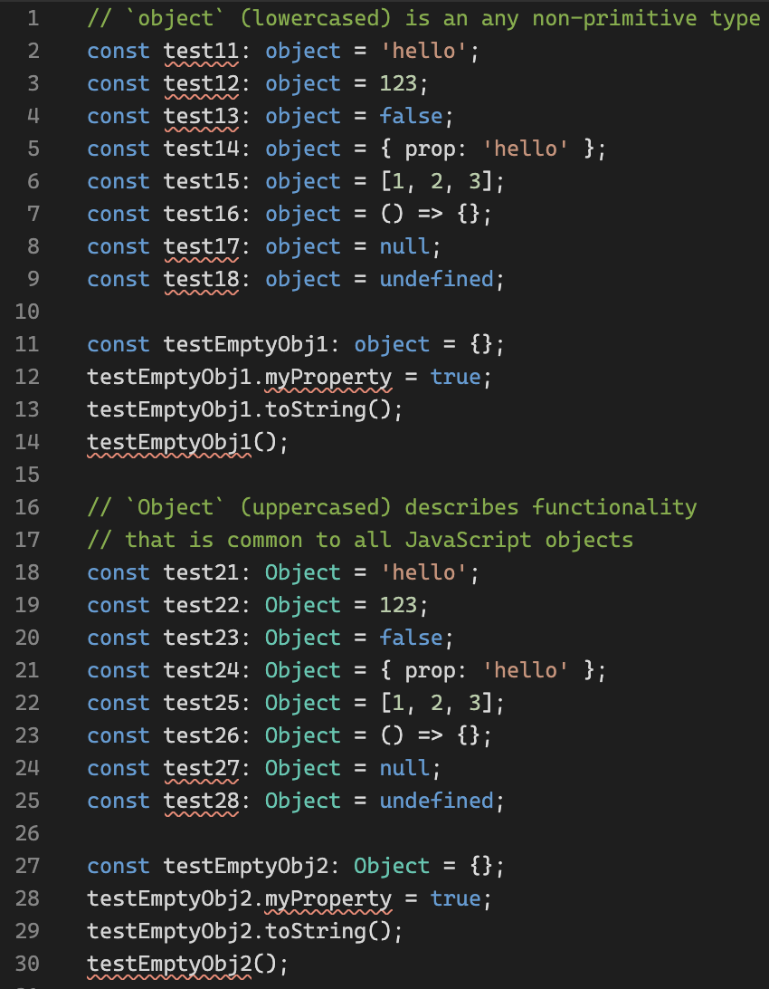
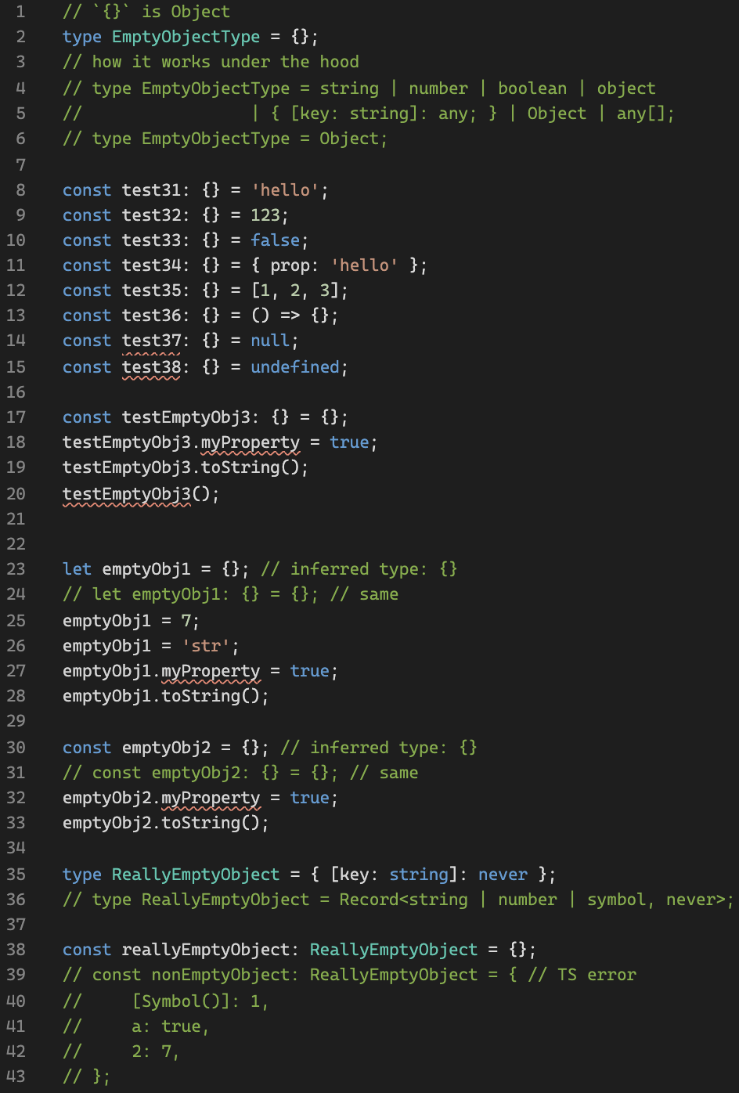
object VS Object VS { }
Playground link
Empty object type
object VS Object
Bootcamp [TypeScript]

Slide 7
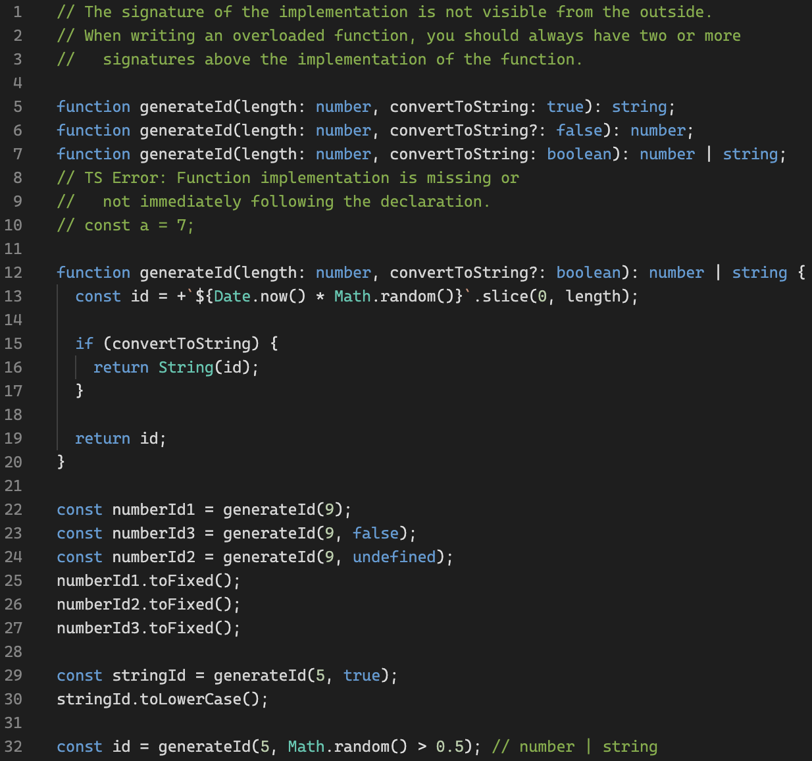
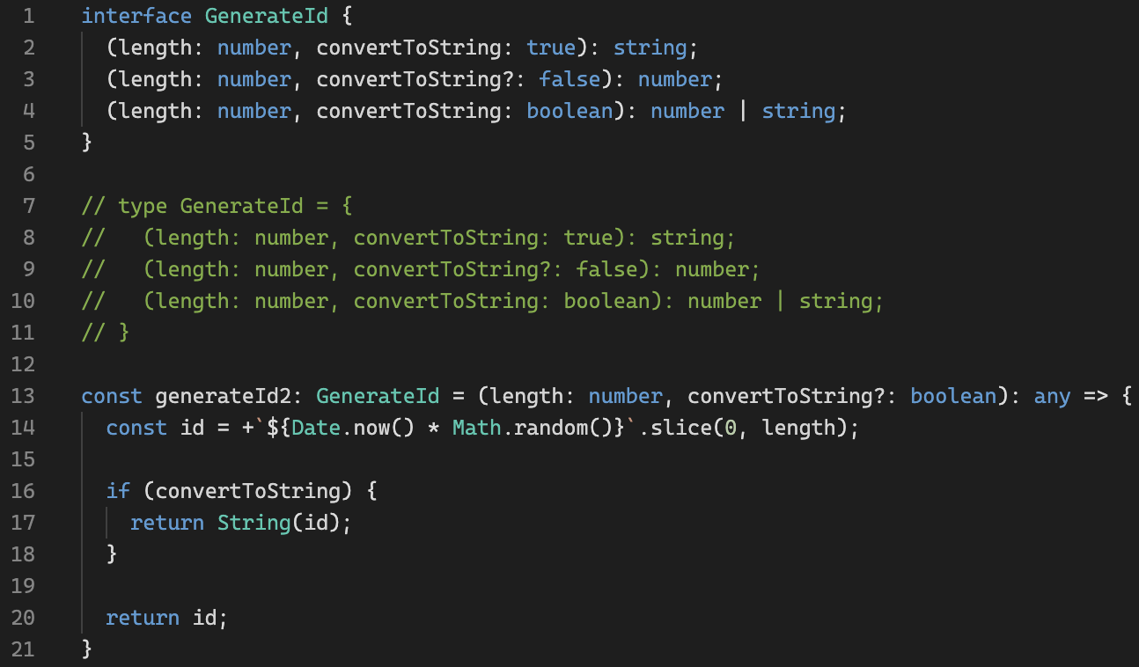
Function Overloads
Playground link
Bootcamp [TypeScript]

Slide 8
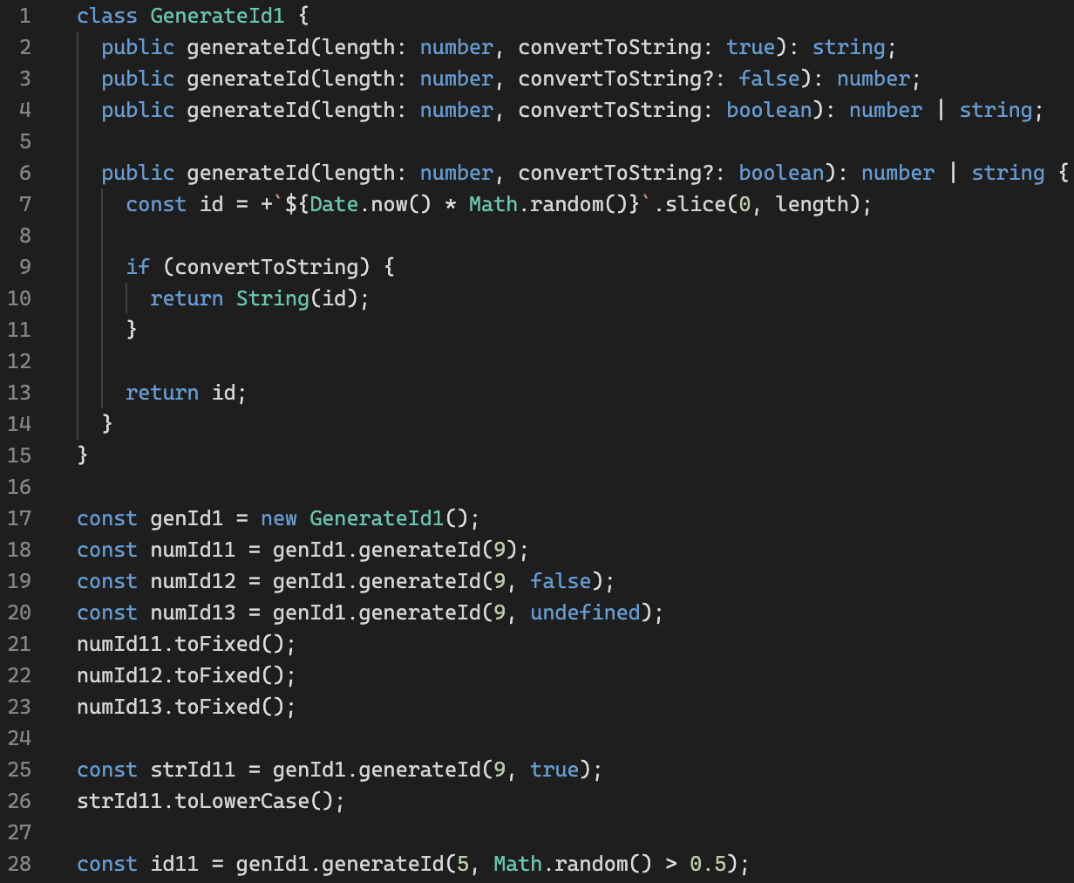
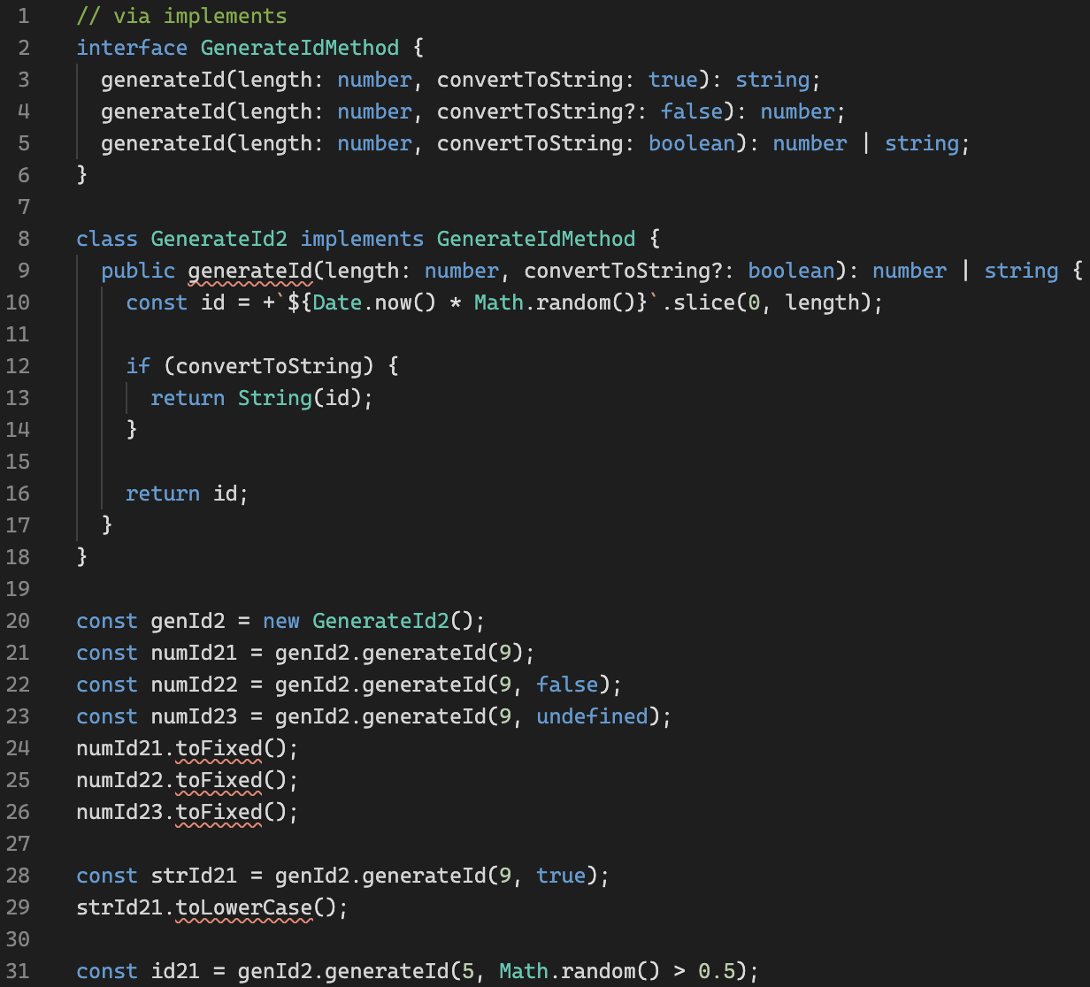
Function Overloads: class
Playground link
Bootcamp [TypeScript]

Slide 9
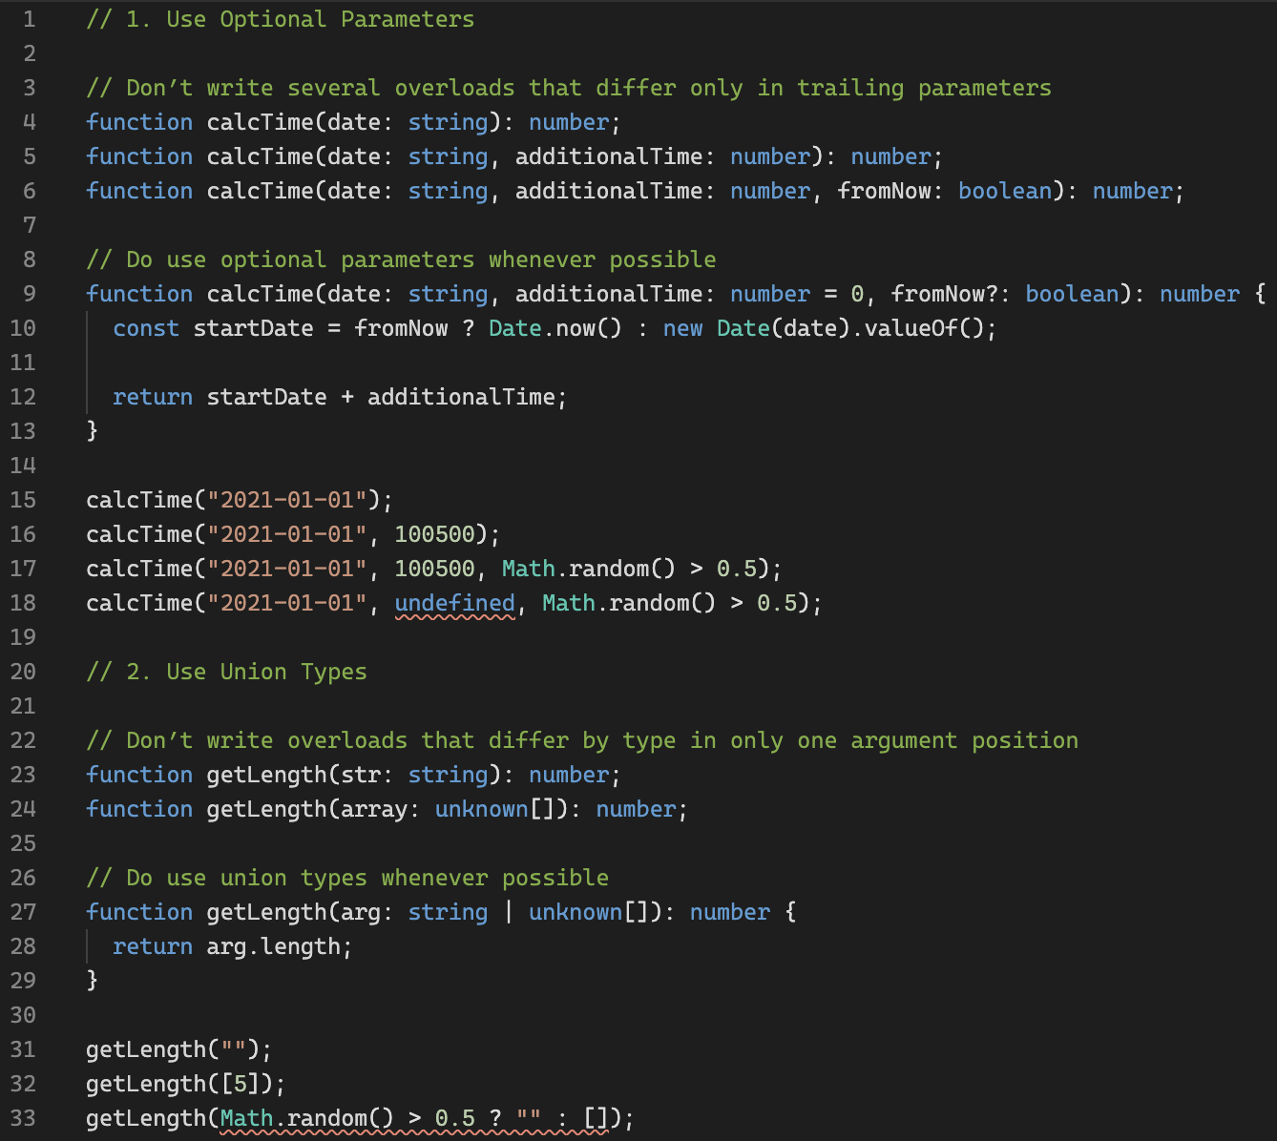
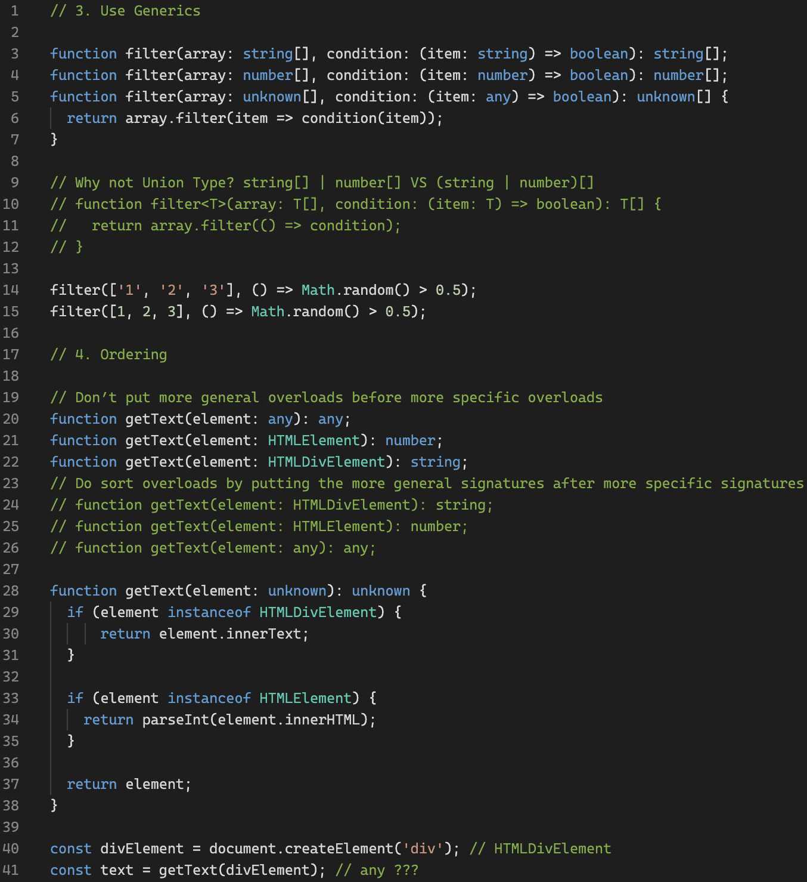
Function Overloads: Do's and Don'ts
Playground link
Bootcamp [TypeScript]

Slide 10
Warm-up
Playground link
Bootcamp [TypeScript]

Slide 11
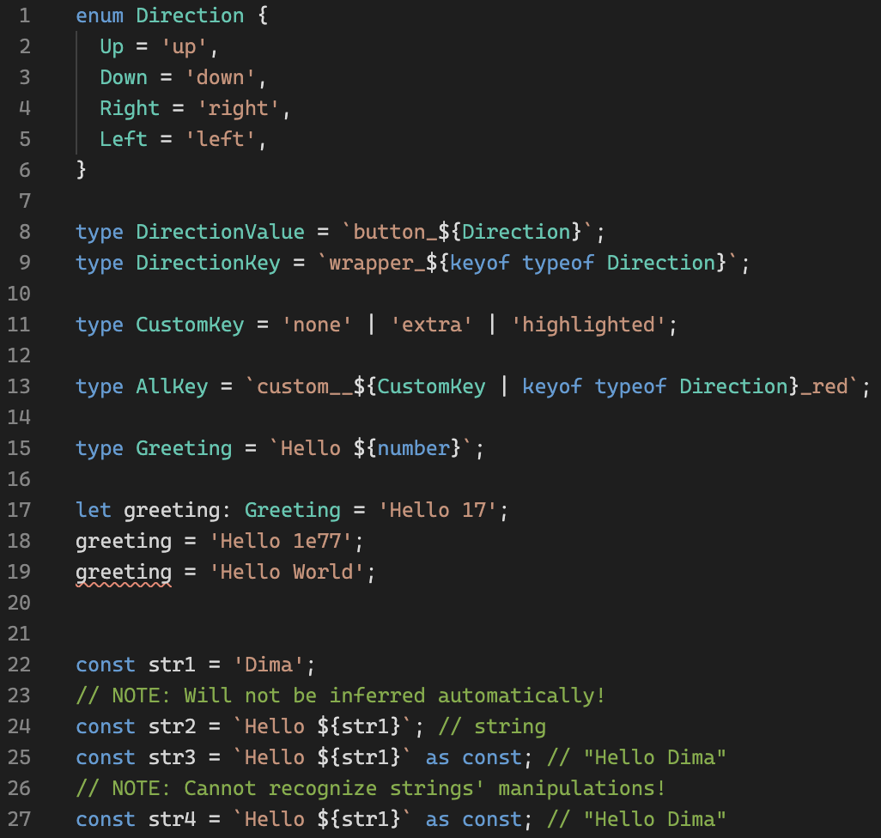
Template Literal Types
Playground link
TypeScript link
Bootcamp [TypeScript]

Slide 12
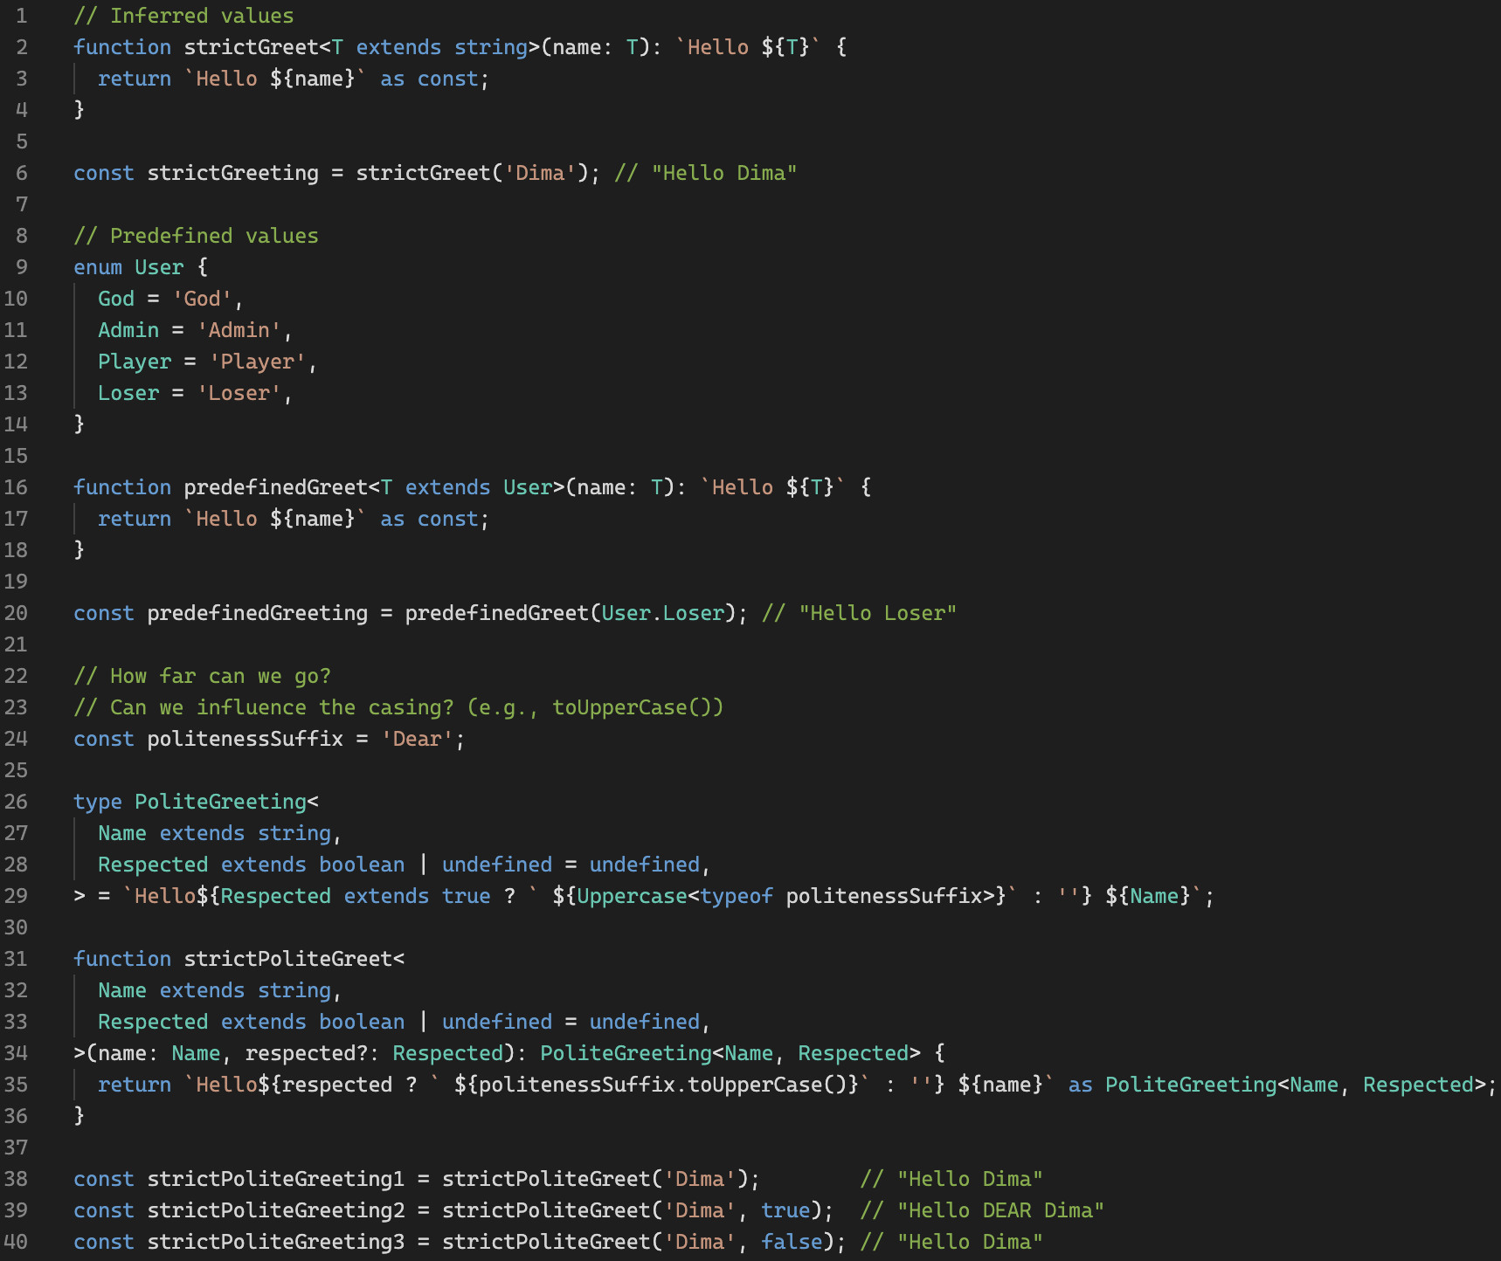
Template Literal Types in functions
Playground link
TypeScript link
Bootcamp [TypeScript]

Slide 13
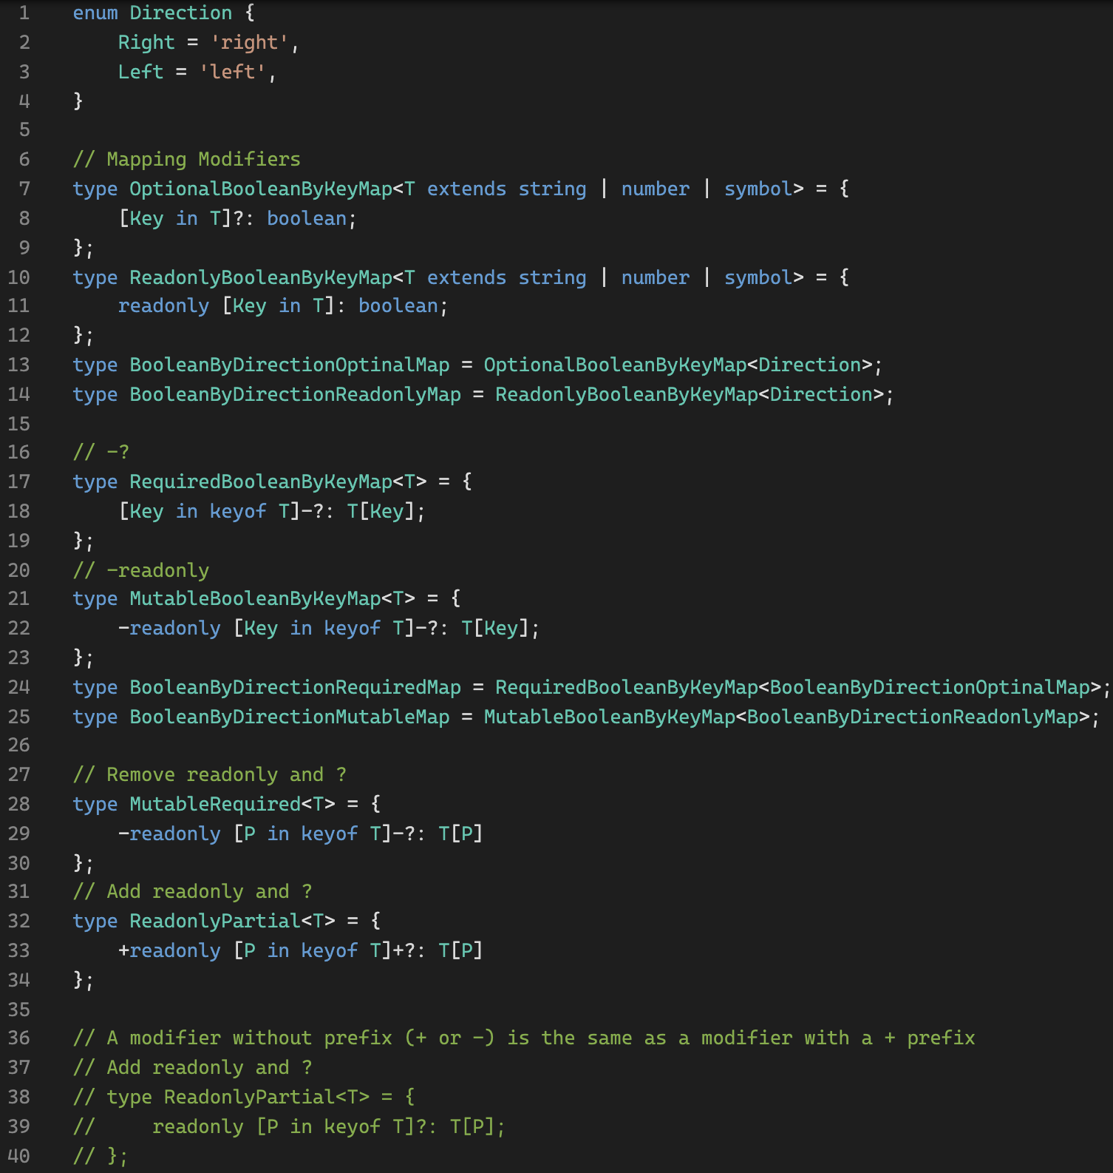
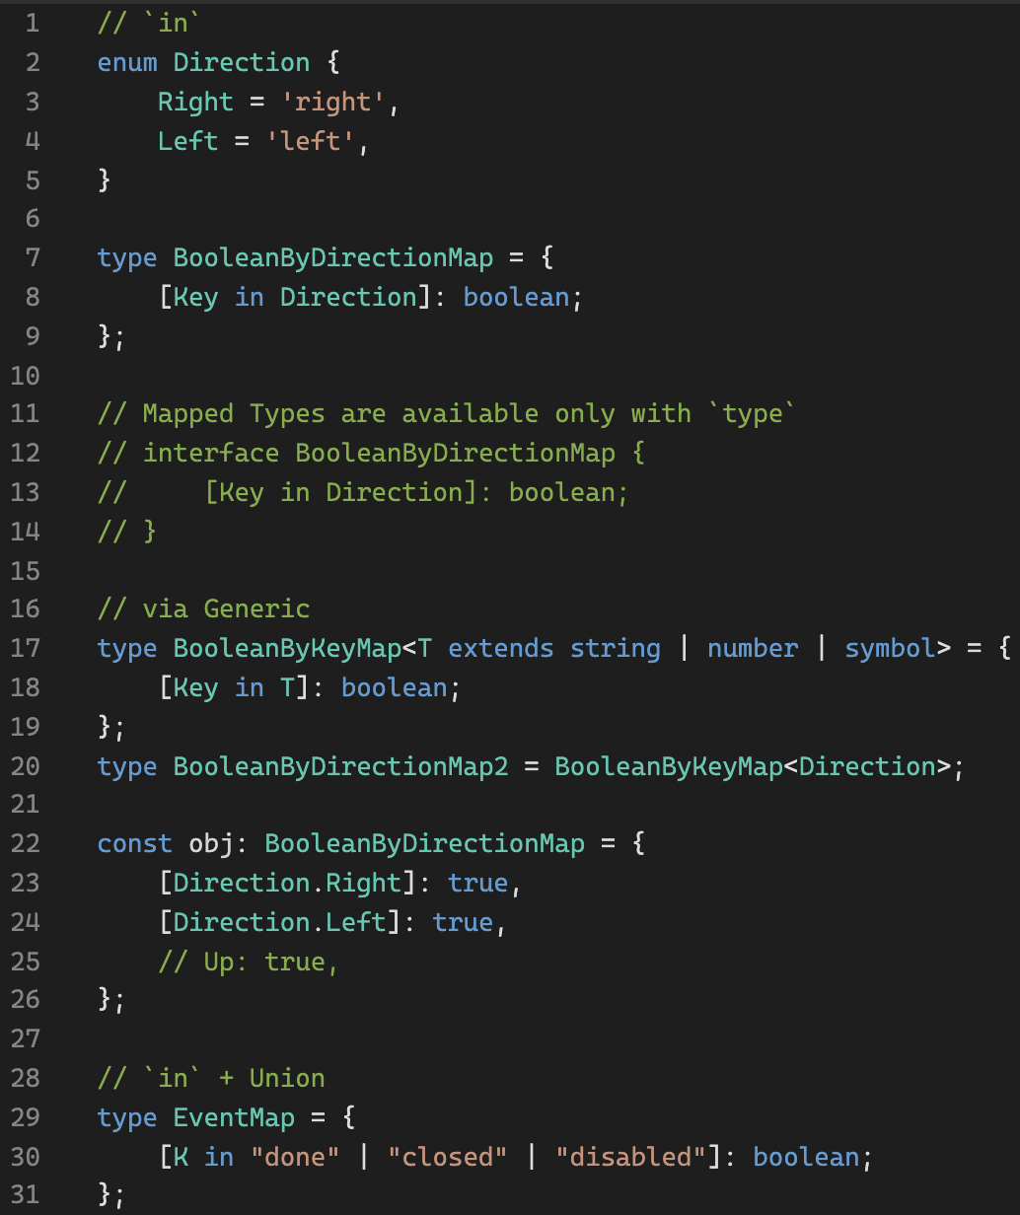
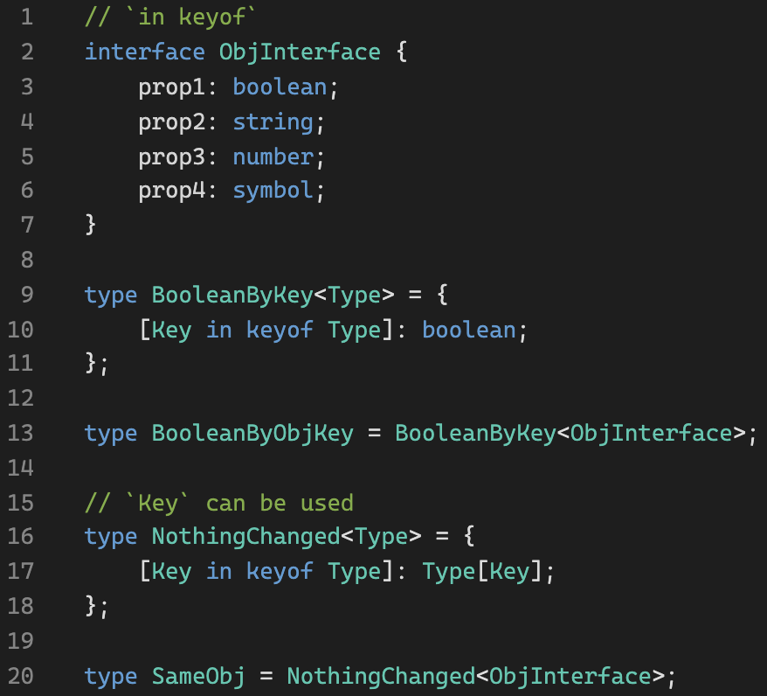
Mapped Types: Reminder
Playground link
Bootcamp [TypeScript]

Slide 14
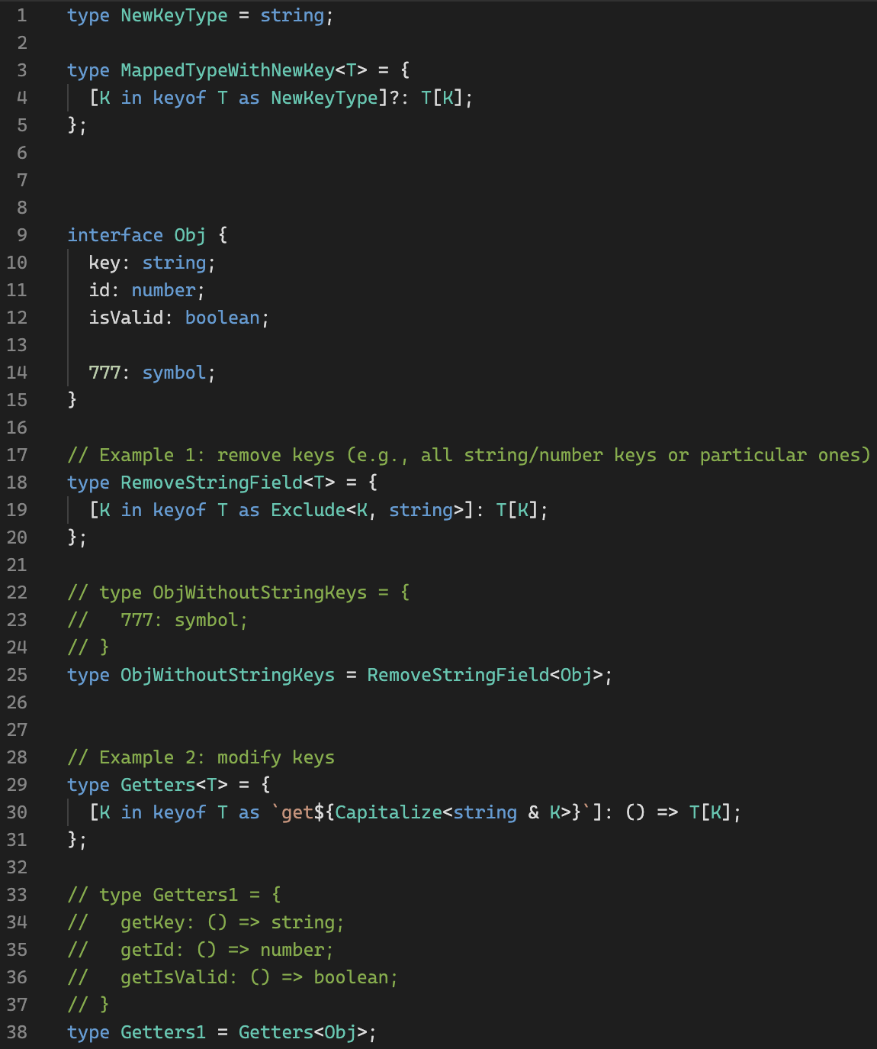
Key Remapping in Mapped Types
Playground link
String Manipulation
Bootcamp [TypeScript]

Slide 15
Warm-up
Playground link
Bootcamp [TypeScript]

Slide 16
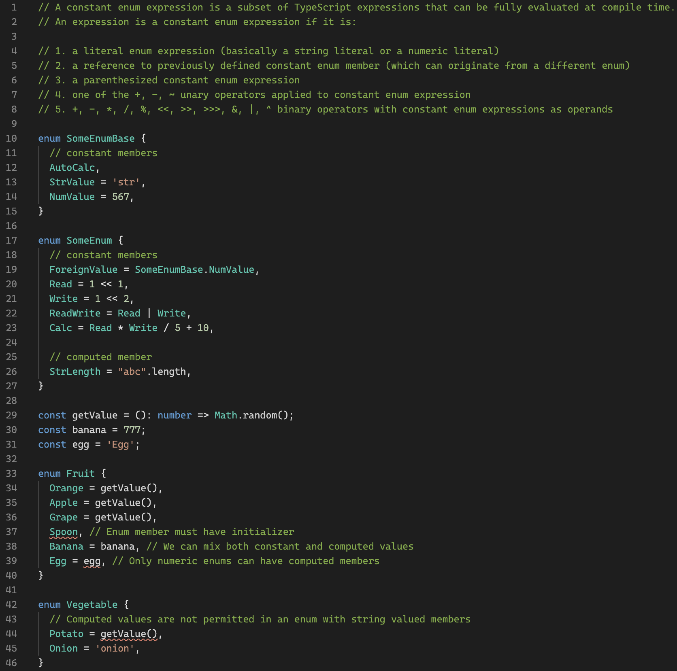
Enum: computed members
Playground link
Bootcamp [TypeScript]

Slide 17
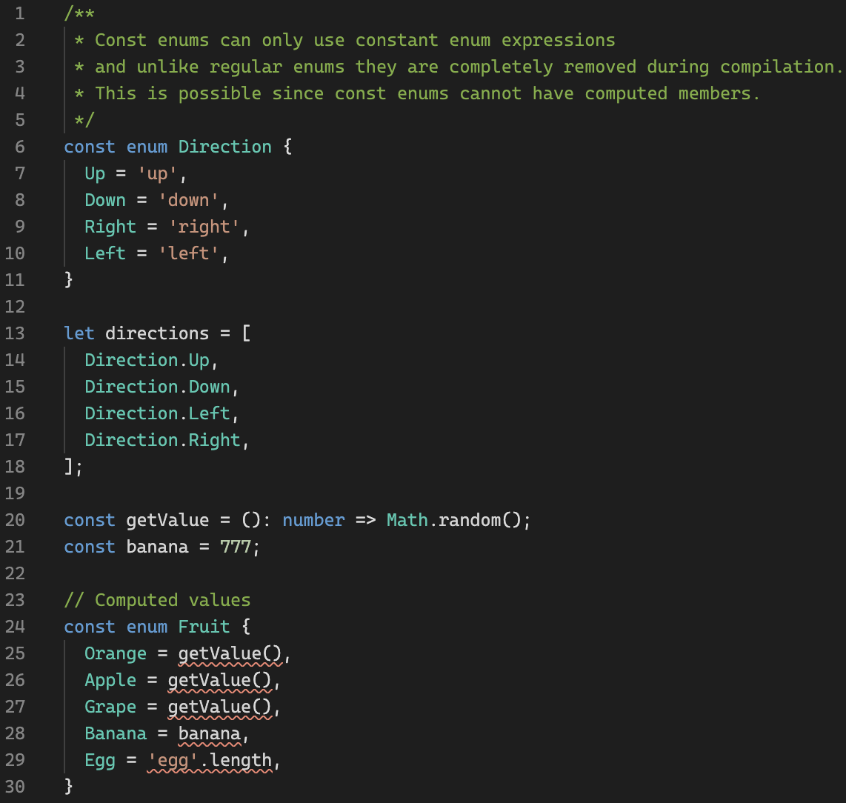
Enum: const enums
Playground link
Bootcamp [TypeScript]

Slide 18
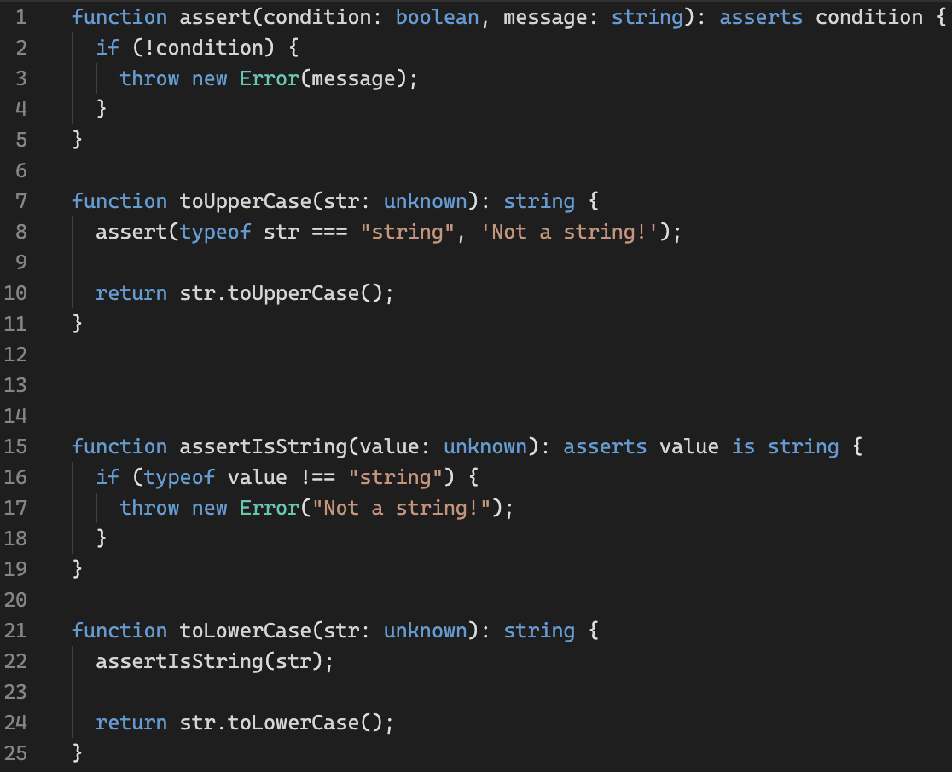
Assertion Functions
Playground link
Bootcamp [TypeScript]

Slide 19
Warm-up
Playground link
Bootcamp [TypeScript]

Slide 20
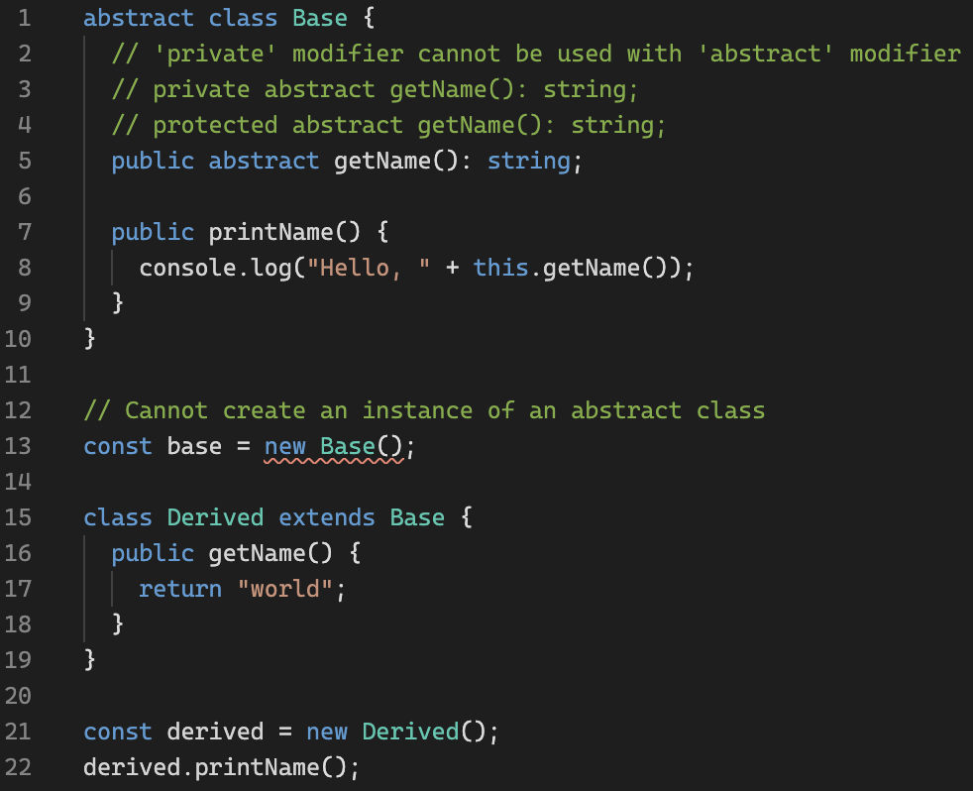
Abstract Class
Playground link
Bootcamp [TypeScript]

Slide 21
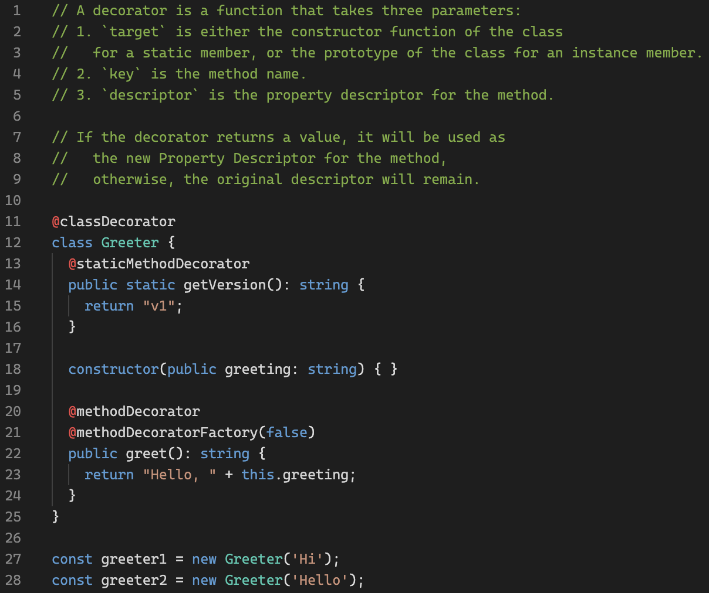
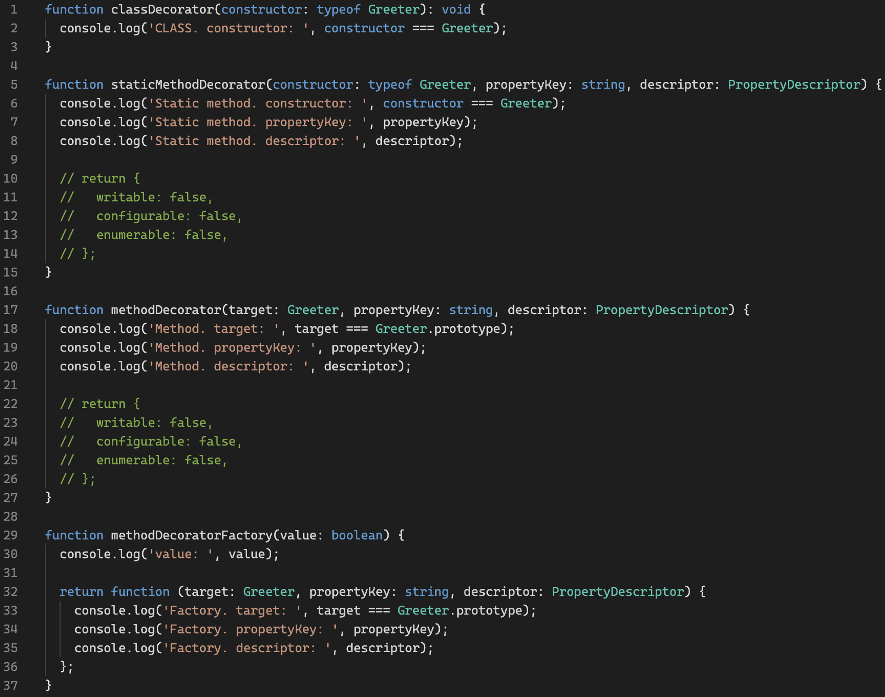
Decorators
Behind the Scenes
TypeScript link
TC39 link
Playground link
Bootcamp [TypeScript]

Slide 22
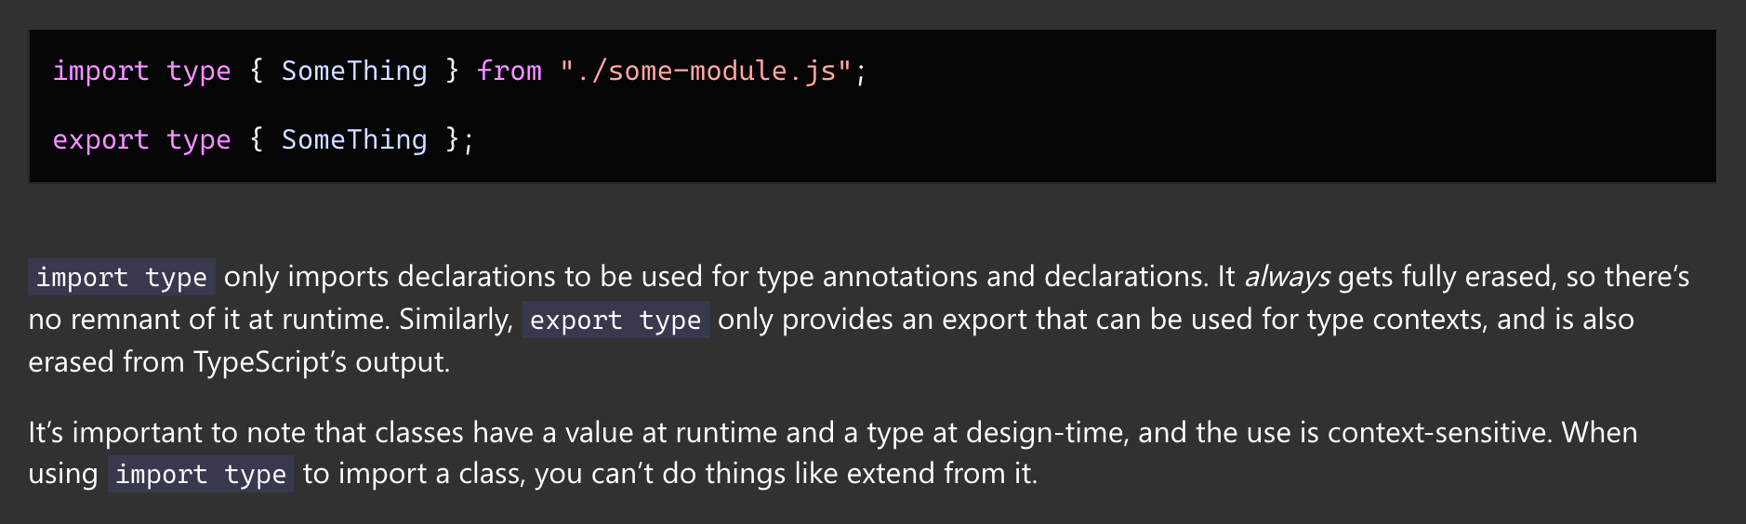
Type-Only Imports and Export
Bootcamp [TypeScript]

Slide 23
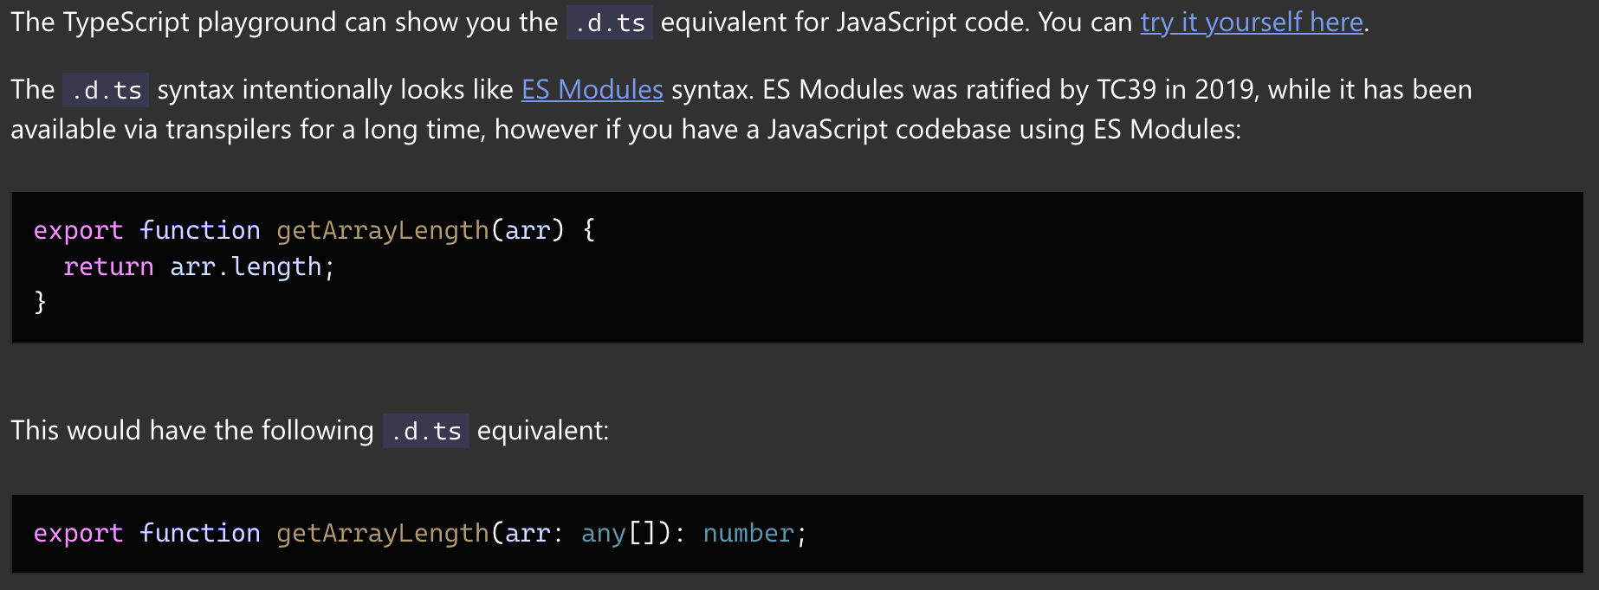
Declaration Files (.d.ts)
TypeScript link
Bootcamp [TypeScript]

Slide 24
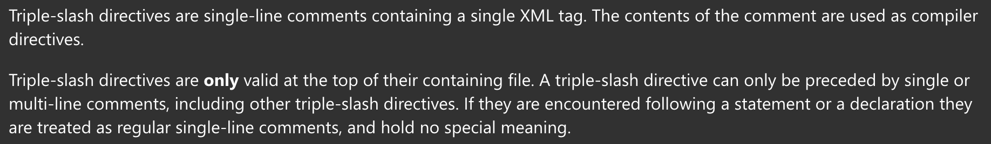
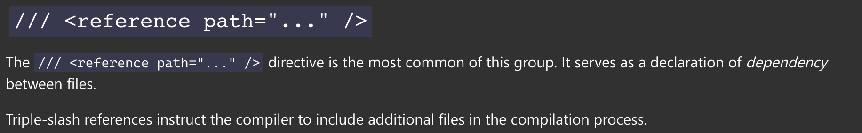
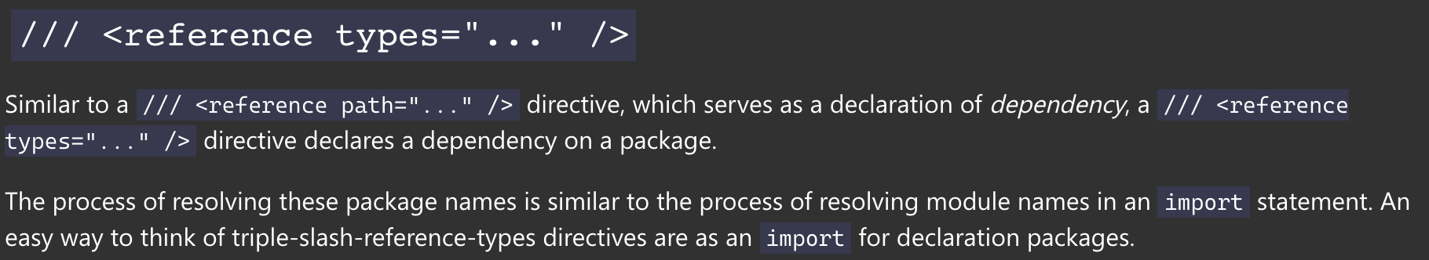

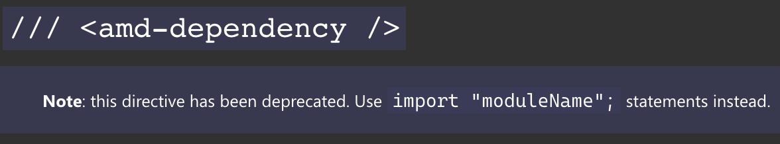
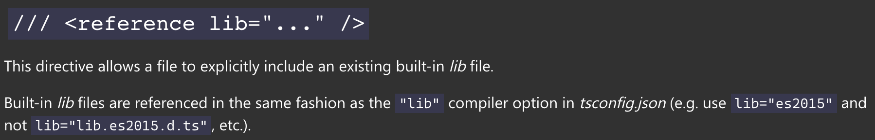
Triple-Slash Directives
TypeScript link
Bootcamp [TypeScript]

Slide 25
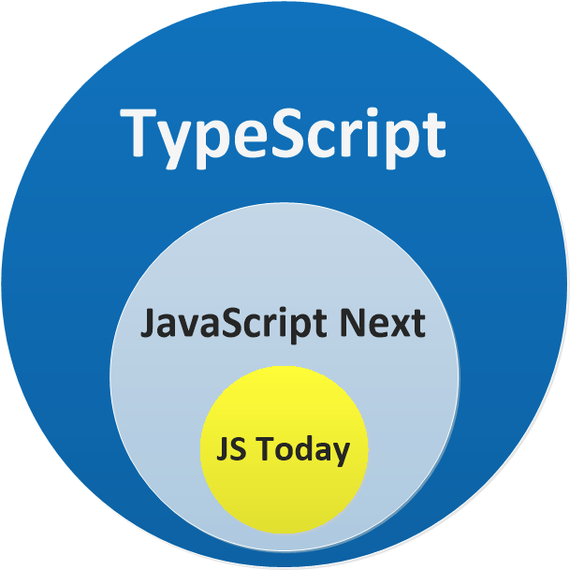
Bootcamp [TypeScript]

Slide 26
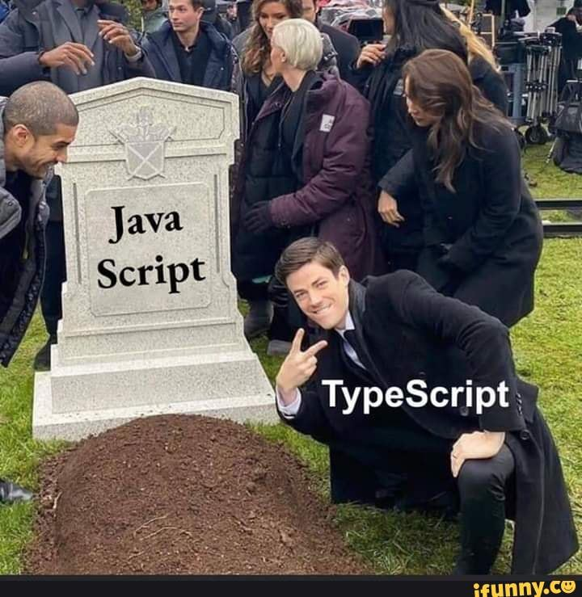
Bootcamp [TypeScript]

Slide 27
Thank you!
Bootcamp [TypeScript]

